Slide 2
NRP in Special Considerations
Dr.Mousavi, Neonatologist

Slide 3
No Improvement After Resuscitation
1. Failure to initiate spontaneous breathing
2. Failure to ventilate
3. Persistent cyanosis or bradycardia

Slide 4
Failure to Ventilate
Mechanical blockage of airway
Impaired lung function

Slide 5
Failure to Ventilate
Mechanical blockage of airway
Meconium or mucus plug
Choanal atresia
Airway malformation (eg, Robin syndrome)
Other rare conditions

Slide 6
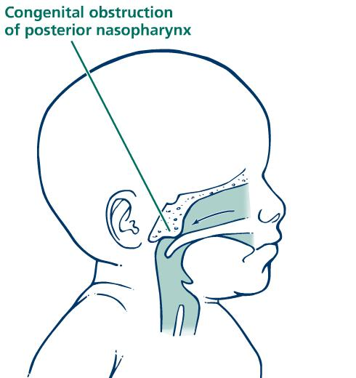
Mechanical Blockage of Airway: Choanal Atresia

Slide 7
Choanal Atresia
Insert a plastic oral airway
Use an ET tube as the oral airway

Slide 8
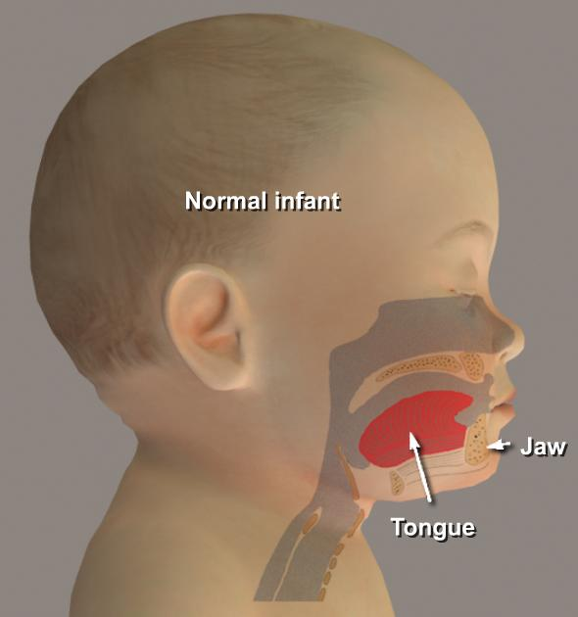
Mechanical Blockage of Airway: Pharyngeal Airway Malformation (Robin syndrome)

Slide 9
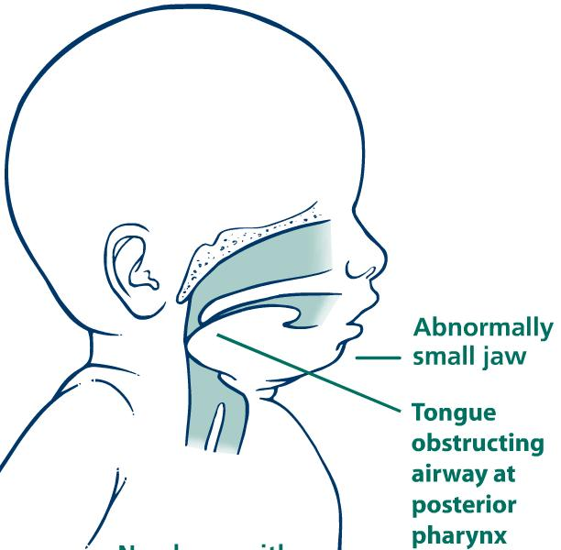
Mechanical Blockage of Airway Robin syndrome
Infant with
Robin syndrome

Slide 10
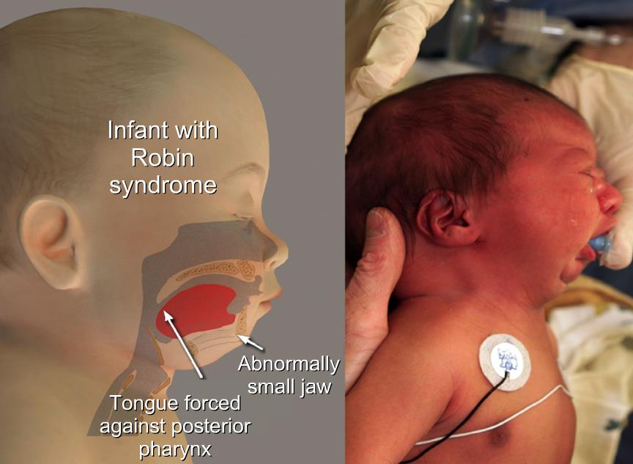
Mechanical Blockage of Airway Robin syndrome

Slide 11
Mechanical Blockage of Airway Robin syndrome
Airway obstruction from Robin syndrome can be helped by inserting a nasopharyngeal tube and placing the baby prone.

Slide 12
Mechanical Blockage of Airway Robin syndrome
The nasopharyngeal tube can be a
large catheter (12 F)
Small endotracheal tube (2.5 mm) through the nose,
with the tip located deep in the posterior pharynx.

Slide 13
Failure to Ventilate
Impaired lung function
Pneumothorax
Congenital pleural effusion
Congenital diaphragmatic hernia
Pulmonary hypoplasia
Extreme prematurity
Congenital pneumonia

Slide 14
Overview
Pneumothoraces are more common in the newborn period than at any other time in life.
This may be due to:
high intrathoracic pressures with the first few breaths
Application of positive pressure mechanical ventilation
Fragility of the premature neonate's lungs.
Spontaneous pneumothoraces estimated to be about 1%, but many are asymptomatic
.

Slide 15
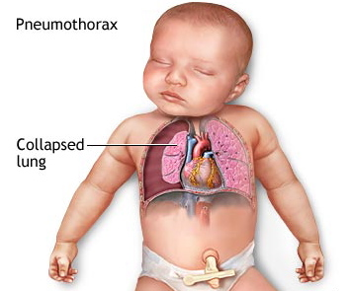
Predisposing Factors:
Prematurity
Difficult delivery
Nuchal cord
Vigorous resuscitation
Mechanical ventilation
Respiratory distress

Slide 16
Predisposing Factors
Pulmonary Hypoplasia
persistent pulmonary hypertension (PPHN)
sepsis
Meconium aspiration syndrome (MAS)
variety of congenital malformations

Slide 17
Signs and Symptoms, conti.
Sudden, unexplained deterioration in the newborn’s condition
Apnea
Bradycardia
Cyanosis
Decreased breath sounds
Increased oxygen requirements

Slide 18
Late Signs and Symptoms
Mottled, asymmetric chest expansion
Decreased arterial blood pressure
Shock-like appearance
Shift in the apical cardiac impulse
Higher PCO₂ and decreased pH
Subcutaneous emphysema

Slide 19
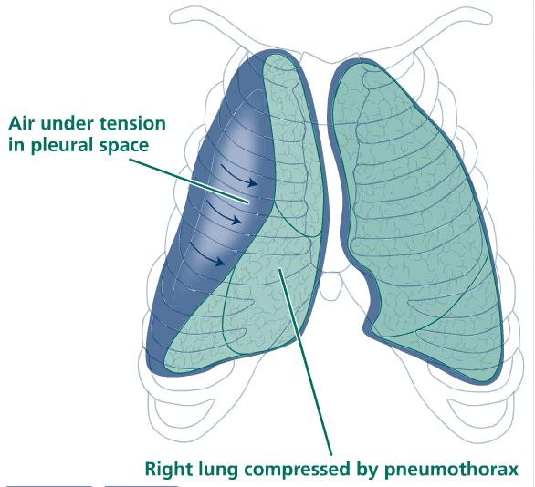

Slide 20
Diagnosis
Pneumothoraces suspected with ph/ex
X-ray examination is the major method for definitive diagnosis of pneumothorax.
Transillumination of the chest can be performed for quick evaluation of the pneumothorax, but can be unreliable.

Slide 21
Diagnosis: CXR
Chest x-ray by the separation of the visceral pleura from the parietal pleura
Appears hyperlucent without pulmonary markings.

Slide 24
Tension pneumothorax
Accumulation of air without a means of escape. Causes
Collapse of the affected lung
Medistinal shift.
respiratory compromise
Decreased venous return, leading to decreased cardiac output and hypotension.

Slide 25
Diagnosis
Transillumination

Slide 27
Transillumination

Slide 29
Needle Thoracentesis
used for diagnostic and therapeutic purposes.
It is an invasive procedure to remove fluid/ air form the pleural space via a needle inserted in the midclavicular line in the 2nd intercostal space.

Slide 30
Chest tube insertion
Place patient in a supine position
Ensuring thermoregulation is maintained for neonates
The patient's arm raised above the head on the insertion side
Maintain ambient oxygen concentration and vital signs
Monitor heart rate, colour and oxygen saturation.
Head of the bed can be elevated 30 – 60 degrees. This lowers the diaphragm and decreased the risk of injury to the diaphragm, spleen or liver

Slide 31
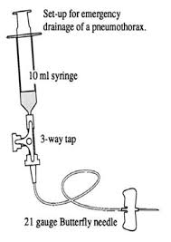

Slide 33
Impaired Lung Function: CDH

Slide 34
Impaired Lung Function: CDH
If a CDH is suspected, avoid PPV by mask
Immediately intubate the trachea and insert a large orogastric catheter (10F) to evacuate the stomach contents

Slide 36
Baby Remains Cyanotic or Bradycardic
Persistent cyanosis and bradycardia are rarely caused by congenital heart disease.
Babies with congenital heart disease are seldom critically ill immediately following birth.
More commonly, the persistent cyanosis and bradycardia are caused by inadequate ventilation

Slide 37
Baby Remains Cyanotic or Bradycardic
Ensure chest is moving with ventilation
Listen for equal bilateral breath sounds
Confirm 100% oxygen is being given
Consider congenital heart block or cyanotic heart disease (rare)

Slide 38
Failure to Initiate Spontaneous Respirations
Consider
Brain injury (hypoxic ischemic encephalopathy)
Severe acidosis
Congenital neuromuscular disorder
Sedation secondary to maternal drugs

Slide 39
Narcotic Antagonist PPV

